Slide 1

Student Details
NAME: A R Gopikrishna
Roll no: AP22110010118
SRM University AP

Slide 2
leveraging data ANALYTICS on Cars data set
I conducted a detailed data analysis on a Car Dekho dataset in collaboration with the EDUNET Foundation. Using Python skills acquired through Python 101, Python for Data Analysis, and Data Visualization courses, I addressed several key questions:
1. Determined the range of manufacturing years for vehicles in the dataset.
2. Identified the lowest and highest selling prices of vehicles.
3. Analyzed the total number of records in the dataset and checked for missing data.
4. Counted the unique vehicle models present.
5. Identified the most sold vehicle and checked for CNG vehicles.
6. Assessed the presence of auto transmission vehicles and vehicles sold by individuals.
7. Determined depreciation trends and identified brands less affected by depreciation.
8. Investigated factors influencing selling prices based on vehicle age and mileage.
9. Segregated data to analyze the newest vehicles (manufactured after 2014), two-wheelers, and cars.
10. Identified the oldest and newest bikes and cars sold.
11. Investigated outliers in two-wheeler and car deals and the reasons behind them.
This analysis utilized Python, pandas, and matplotlib/seaborn for visualization, providing insights into vehicle sales dynamics and market trends.

Slide 3
AGENDA
Project Overview
End Users of this project
Solution and it’s value proposition
Customizations
Modelling
Results
Project Link
Reference Links

Slide 4
PROJECT OVERVIEW
Objective: To analyze and derive insights from a dataset about cars and bikes.
Content: Includes attributes such as make, model, year, price, performance metrics (speed, acceleration), fuel efficiency, type (car or bike), etc.
Project Phases and Tasks:
1. Data Exploration and Preparation.
2. Exploratory Data Analysis.
3. Advanced Analysis and Modeling.
Tools and Technologies:
1. Python for data analysis and modeling (using libraries like Pandas, NumPy, Matplotlib, and Seaborn).
2. Development Environment like Jupyter Notebook Google Colab.

Slide 5
Who are the end users of this project?
After analyzing the dataset, the project can be customized based on the end user:
Consumer Focus: Prioritizing factors such as vehicle manufacturing year, pricing, and transmission details.
Industry Focus: Highlighting market trends, competitive analysis, and regulatory influences.
Academic Focus: Offering detailed statistical analysis and insights tailored to specific research questions.

Slide 6
YOUR SOLUTION AND ITS VALUE PROPOSITION
I completed this project using Python libraries such as Pandas, NumPy, Matplotlib, and Seaborn, focusing on data analysis and visualization. The solution will follow a structured approach from data loading to visualization, covering essential aspects of data analysis. These Python libraries are well-documented and widely used, making them accessible to users with different levels of expertise. My approach emphasizes the technical aspects of data analysis and the significance of deriving actionable insights through effective visualization and interpretation.

Slide 7
How did you customize the project and make it your own
I personalized the project by exploring various visualization libraries and techniques, including interactive visualizations, to enrich engagement and enhance data exploration. Understanding the dataset provided was crucial in tailoring the project to meet its objectives effectively.
The customization primarily focused on three key components: understanding the data, thorough data cleaning, and utilizing advanced visualization methods to achieve desired outcomes. This approach not only made the project more engaging but also allowed for a deeper exploration and presentation of insights from the data.

Slide 8
MODELLING
In the realm of Data Visualization, "models" generally denote distinct types of plots or charts utilized to visually depict data in diverse manners. These models or visualization types are selected based on the specific characteristics of the data and the insights intended for communication. Here are several prevalent models or types of visualizations frequently employed in data visualization:

Slide 9
Scatter Plots: Used to visualize the relationship between two numerical variables. Each point represents an observation.
Line Charts: Typically used to show trends over time or continuous data points. Useful for displaying data with sequential or time-based values.
Bar Charts: Used to compare categories of data. Bars represent different categories, and the height of each bar represents the value of the category.
Histograms: Shows the distribution of a single numerical variable. It bins the data into intervals and shows the frequency of observations in each interval.
Pie Charts: Represents proportions of a whole. Useful for showing parts of a single entity or category.
Box Plots: Displays the distribution of numerical data based on quartiles. Useful for detecting outliers and understanding the spread of the data.

Slide 10
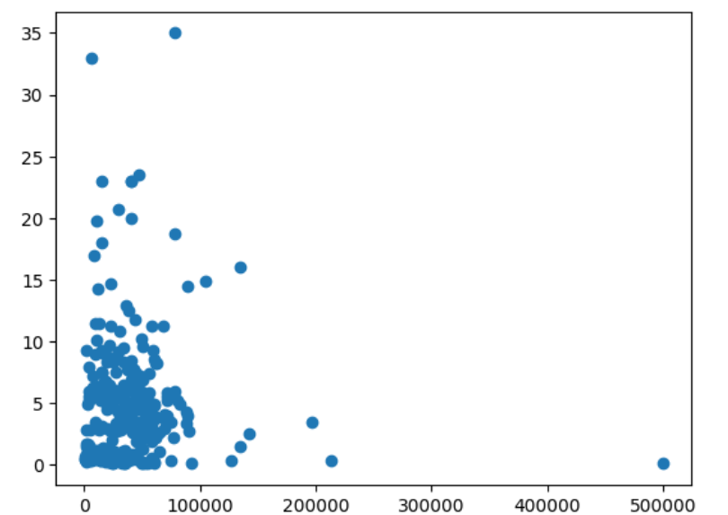
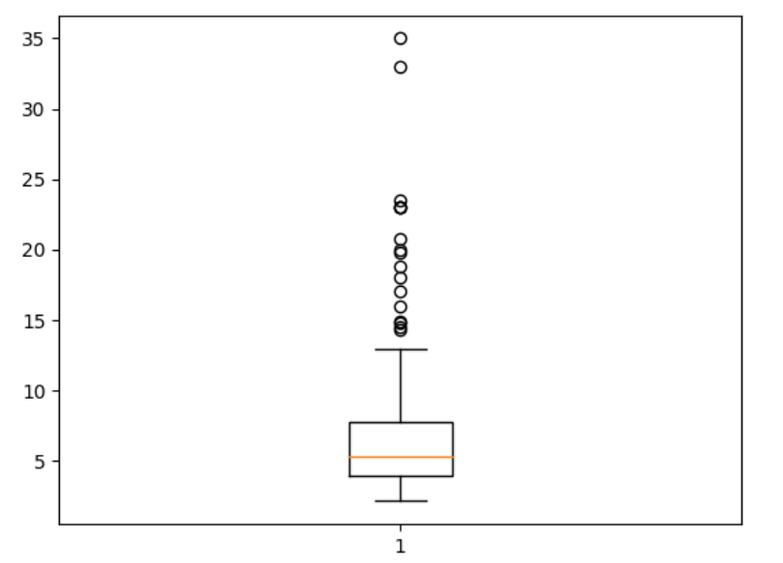
Results

Slide 11
Project link
https://drive.google.com/drive/folders/15etk2HBqoVm6Hd6u4E7mKwbeiEGleSkA?usp=sharing

Slide 12
Reference Links
https://skills.yourlearning.ibm.com/activity/PLAN-BC0FAEE8E439
https://skills.yourlearning.ibm.com/activity/PLAN-B6CBEFCA2BFD

Slide 13
THANK YOU

